Slide 1
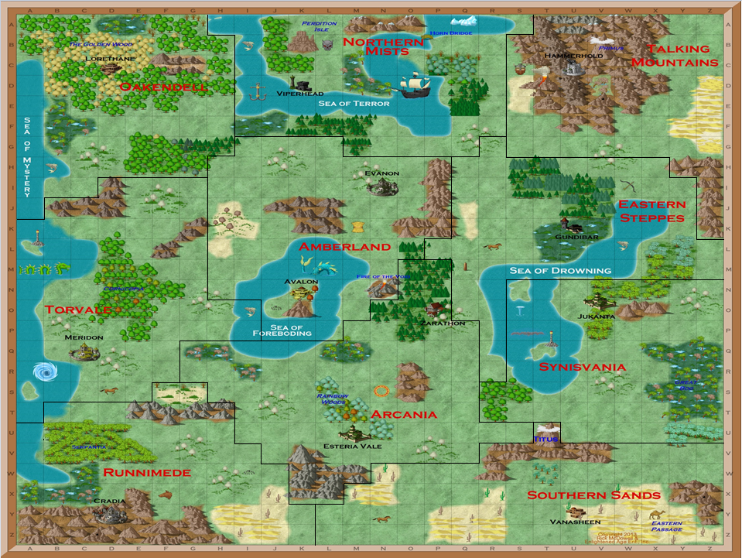
KINGDOM ICONS
City
#
Village
HUMAN
#
#
Town
#
Group
Unknown
#
#t
PC w/temple
Neutral
#
EL/DU
CI/NE
DW/WA
SO/AM
EM
EM
EM
EM
1
2
1
2
1
2
1
2
3
4
3
4
3
4
3
4
BL/SA
AT/DE
GN/HA
RA/IL
EM
EM
EM
EM
1
2
1
2
1
2
1
2
3
4
3
4
3
4
3
4
LI/DA
NO/AN
PI
RD/TY
EM
EM
EM
EM
1
2
1
2
1
2
1
2
3
4
3
4
3
4
3
4
Superior
Sup US
Fine
Fine US
Port: AA
Portal
Quest
Cleared US
Ward
No PC
No Sighting
All Cleared
Notes:
Send emmies to the city in hopes that the RD will accept my proposal to allow me to have the city. Scout with the 1DW. Moved the 2DW to the US to get the Axe of Farin.

